Slide 1



CCRN Review Course
Day One 8:00 – 5:00
Day Two 8:00-5:00
Neurological 12%
Behavioral/Psychosocial 4%
Hematology/Immunology 2%
Multisystem 8%
Renal 6%
Cardiovascular 20%
Cardiovascular cont.
Pulmonary 18%
Endocrine 5%
Gastrointestinal 6%
Professional Caring and Ethical Practice 20%

Slide 2
150 multiple choice questions, 125 which will be scored
25 questions remain unscored and used by the AACN to plan for future exams
You will receive your score immediately upon completion
Avoid mental fatigue: practice, practice, practice!

Slide 3
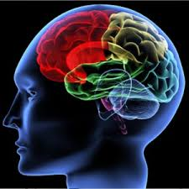
CCRN REVIEW: Psychosocial
PSYCHOSOCIAL
4%
Antisocial Behavior
Delirium/Dementia
Mood Disorders
Substance Dependence
Suicidal Behavior
6 Questions

Slide 4

In Dealing with Patients with a Psychosocial Emergency – COMMUNICATION is Key!
Basic Communication Techniques
Listening
Accepting
Offering of self
Open ended questions
Restatement and paraphrasing
Encouraging description of perceptions
Seeking clarification
Empathy

Slide 5
In Dealing with Patients who are Aggressive, Abusive, Violent:
Identify yourself and your role
Speak slowly and clearly
Use a calm and reassuring tone
Show you are listening to the patient by rephrasing back parts of what he or she says
Do not be judgmental
Show compassion
Use positive body language
DO NOT ENTER THE PATIENTS SPACE – stay 3 feet away
Be alert for changes in the patients emotional status

Slide 6
USE OF RESTRAINTS
EXTREMLY OR USUALLY APPROPRIATE
Acute danger to other patients, staff or self
SOMETIMES APPROPRIATE
To prevent an involuntary patient from leaving
RARELY OR NEVER APPROPRIATE
A history of previously self-injury or aggression
Lack of resources to supervise patient
To prevent a voluntary patient from leaving

Slide 7
A patient under the nurse’s care has required physical wrist restraints due to her delirium. At the end of the nurse’s shift, the patient begins to follow verbal commands, speak pleasantly, and ask for water. What is the best method available to the nurse to assess the patient’s cognitive function?
Consultation with another nurse
Perform a physical assessment
Ask the patient’s family if they believe the patient is at her functional baseline level
Mini mental status exam

Slide 8
In which of the following situations would the use of physical restraints be most appropriate?
Bipolar patient in a manic state
Aggressive patient trying to pull out his indwelling Foley catheter
Patient with a history of substance abuse resting quietly
Elderly patient with a history of dementia exhibiting possible sundowning behavior

Slide 9
The nurse is caring for a patient who is considered at increased suicide risk. What symptoms might lead the nurse to believe that the patient is imminently contemplating suicide?
Elevated heart rate, complaints of pain
Outgoing behavior, aggressive behavior
Expressing acceptance of death, flat affect
Complaints of chest pain, manic behaviors

Slide 10
A patient with a history of substance abuse and schizophrenia is admitted to the hospital. He is currently displaying elements of antisocial behavior, including impulsiveness and aggression. What is the best nursing approach to take toward Mr. D in order to prevent his behavior from becoming violent.
The nurse should approach the patient cautiously with clear communication, using rigid assessment skills and setting clear patient-nurse boundaries.
The nurse should quietly approach the patient and limit communication as much as possible
The nurse should be equally aggressive with the patient, as allowing the patient’s behavior to alter the nurse’s actions will only make the potential behavior more likely.
The nurse should approach the patient in a punitive manner, use short phrases for communication, and use the threat of restraints to persuade the patient to regress fro potential violence.

Slide 11
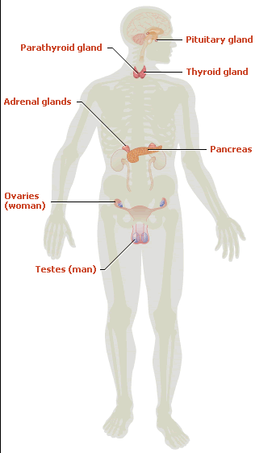
CCRN REVIEW : Endocrine
ENDOCRINE
5%
SIADH
Diabetes Insipidus
DKA & HHNK
Hypoglycemia
7 Questions

Slide 12



ADH
Made in your Hypothalamus
Stored in your Posterior Pituitary gland
ADH =

Slide 13


Syndrome of Inappropriate Secretions of Antidiuretic Hormone (SIADH)
Too Much ADH
Dilutional Hyponatremia
Decreased Na
Decreased Urinary Output
Decreased Osmolality
Normal osmolality 275-295 mOsm/kg

Slide 14
Causes
(over 9 million causes; only need to know 3 for the exam☺)
OAT CELL CARCINOMA
Or
Bronchogenic Cancer
HEAD PROBLEM
VIRAL PNEUMONIA
Increased serum osmolality
Anesthesia
Analgesics
Stress

Slide 15

ADH
Na + Levels (Serum Na + < 120 mEq/liter)
Serum Osmolarity (< 270 mOsm/kg)
Urinary Output (less than 0.5 ml/kg/hr)
SIADH = Dilutional Hyponatremia

Slide 16
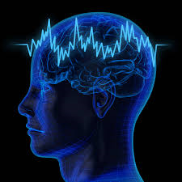
COMPLICATION
Seizure Activity

Slide 17
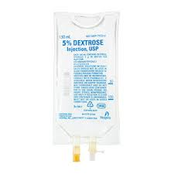
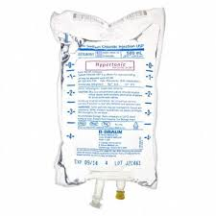
TREATMENT
Treat the cause: Get rid of the Oat Cell Carcinoma, Viral Pneumonia or Head Problem
Fluid Restriction
Hypertonic Solutions
3% Sodium Chloride
1030 mOs./liter
25-50 ml/hr for 3-4 hours
No
Hypotonic
Solutions

Slide 18
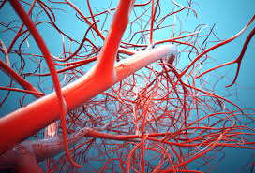
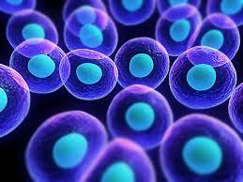

0.45 % Saline 155
0.33 % Saline 100
2.5% Dextrose 130
D5W 275
D5W 245
240
280

Slide 19

3% Sodium Chloride 1030
D5NS 565
D5 ½NS 406
1030
280
Assess for fluid overload & CHF

Slide 20
Diabetes Insipidus (DI)
No ADH
Increased Na Levels
Hypernatremia
Increased Urinary Output (6-24L/day)
Increased Osmolarity

Slide 21
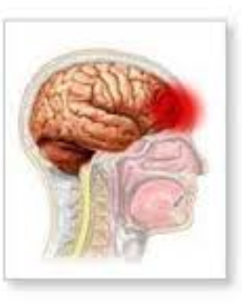
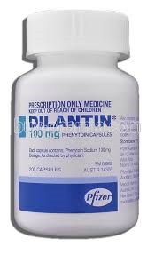
Diabetes Insipidus (DI)
Causes
(Many causes; only need to know 2 for the exam☺)
Head Problem
Dilantin

Slide 22

Diabetes Insipidus (DI)
ADH
Na+ Levels
Serum Osmolality
Urinary Output (1.001-1.005)
Notes:
Normal Specific gravity 1.002 and 1.030

Slide 23
Diabetes Insipidus (DI)
Complication
Hypovolemic Shock
Notes:
40Liters in your body

Slide 24

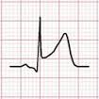
Diabetes Insipidus (DI)
TREATMENT
Give ADH
Pitressin or Vasopressin
Give fluids to increase intravascular volume
Monitor EKG for Ischemia
Monitor Urine Specific Gravity

Slide 25

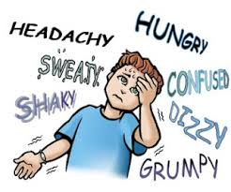
HYPOGLYCEMIA
CVS
Tachycardia
Palpitations
Diaphoresis
Irritable
Restlessness
CNS
Confusion
Lethargy
Slurred Speech
Seizure
Coma

Slide 26

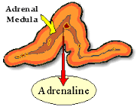
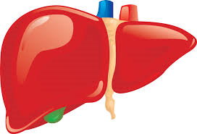
Low-Blood Sugar
Glycogen Glucose

Slide 27
HYPOGLYCEMIA
Beta-Adrenergic Blockers
CVS
Tachycardia
Palpitations
Diaphoresis
Irritable
Restlessness
CNS
Confusion
Lethargy
Slurred Speech
Seizure
Coma

Slide 28


Diabetic Ketoacidosis (DKA) Vs. Hyperosmolar Hyperglycemic Syndrome (HHS)
BS 400 – 900
Dehydration
(4-6 liters)
BS 1000- 2000
Severe Dehydration
(6-8 liters)
No Insulin
+ Insulin
+ Acidosis
Kussmaul Respirations ( rate & depth)
No Acidosis
LTBB
Insulin Dependent Diabetics
Diet Controlled Diabetics
Old Age
TPN
Pancreatitis

Slide 29
Diabetic Ketoacidosis (DKA) Vs. Hyperosmolar Hyperglycemic Syndrome (HHS)
TREATMENT
Insulin Drip
&
Fluids
Fluids
&
Insulin
Normal Saline 1st for intravascular hydration
0.45% Saline 2nd for intracellular hydration
D5 ½ Saline 3rd when glucose 250-300 to prevent hypoglycemia

Slide 30
Δ pH 0.1 Reciprocal Change K+ 0.6
In a state of acidosis, potassium will shift out of the cell and hydrogen will shift into the cell……
There is a shift between potassium and hydrogen ions.
H+
K+
PH
7.45
7.35
7.25
7.15
7.05
K+
4.5
5.1
5.7
6.3
6.9

Slide 31
What is the effect of ADH on urine formation?
Retention of sodium and water, excretion of potassium
Excretion of sodium and water, excretion of potassium
Retention of water, concentration of urine
Excretion of water, dilution of urine

Slide 32
The releasing stimulus for ADH is normally:
Decreased serum osmolality
Increased serum osmolality
An elevated circulating cortisol level
Increased serum potassium levels

Slide 33
The normal serum osmolality is within the range of:
145-155 mOs./L
200-250 mOs./L
275-295 mOs./L
325-375 mOs./L

Slide 34
The syndrome of inappropriate antidiuretic hormone (SIADH) is manifested clinically as a:
Hyperosmolar state
Low output state
Myxedema state
Water intoxication state

Slide 35
In addition to its affect on body water equilibrium, ADH is also a:
Vasopressor
Beta stimulator
Cardiogenic
Carbonic anhydrase inhibitor

Slide 36
The “cardinal sign” of inappropriate ADH secretion is:
Dilutional hyponatremia
Urine output of 10 L per day
Hypotension
Systemic edema

Slide 37
Which of the following laboratory findings would be present in a patient with SIADH?
Serum osmolality of 350
Low serum sodium
Urine specific gravity of 1.003
Decreased urinary osmolality

Slide 38
The patient with SIADH may present with:
Increased urinary output
Hypertension
Seizures
Increased potassium levels

Slide 39
Which of the following patients would be likely to develop DI?
An elderly patient receiving thiazides
A young woman with severe pneumonia
A 50 y/o with esophageal varices on Pitressin
A head trauma pt. with a skull fracture

Slide 40
During your assessment, which of the following findings would be present in a patient with DI?
Serum osmolality of 250
Serum sodium level of 165
Urinary output of less than 600 ml in 24 hours
Urine specific gravity of 1.025

Slide 41
As a nurse, you understand that a major complication of DI is:
Hypovolemic shock
Seizures
Congestive heart failure
Cardiac arrhythmias from hypokalemia

Slide 42
Evaluation of laboratory findings in a patient with DI would show:
Increased urine osmolality
Urine specific gravity between 1.001 to 1.005
Decreased serum sodium
Decreased serum osmolality

Slide 43
The most dangerous complication of Diabetes Insipidus is:
Dilutional hyponatremia
Hypovolemia
Congestive heart failure
Water intoxication syndrome

Slide 44
Diabetes insipidus is characterized by ALL BUT WHICH of he following?
Urine Specific gravity of 1.015
Tachycardia
Urinary output of 2000 ml in three hours
BP 90/40

Slide 45
Which of the following is characteristic of Diabetes Insipidus?
Low urine osmolality
Serum osmolality increase
Serum sodium elevated
All of the above

Slide 46
A 68 year-old is admitted with a bold sugar of 1200; she is severely dehydrated, respirations are 18 per minute and shallow: You would first suspect?
Hyperosmolar syndrome
Diabetic ketoacidosis
Either of the above
Neither A or B

Slide 47
It is important for the nurse to identify those patients at risk for developing HHNK. Which condition would NOT predispose a patient to develop HHNK?
Pancreatitis
Thiazide or steroid therapy
TPN therapy
Cerebrovascular accident

Slide 48
HHNK is NOT usually associated with:
Use of diuretics, steroids and hypertonic solutions
Mild diabetes of recent onset
Older age
Defects in ADH secretion

Slide 49
The nurse understands that the primary cause of the classical manifestations of HHNK is:
Rapid decrease in plasma osmolality
Markedly elevated serum glucose
Intravascular dehydration
Serum electrolyte abnormality

Slide 50
The altered mental status in a patient in HHNK results from:
Hyperosmolality of the plasma
Intracerebral dehydration
Severe osmotic diuresis from hyperglycemia
Intravascular dehydration

Slide 51
Which of the findings would NOT be present in HHNK?
Kussmaul’s respirations of 28/minute
Serum glucose level above 650 and often greater than 1000
Serum osmolality above 350 mOso/L
Severe dehydration and the absence of ketoacidosis

Slide 52
Evaluation of a patient’s laboratory values with HHNK would include:
A serum sodium of 123
A serum osmolality of 340 mOsm/L
A urinary sodium of 60
A bicarbonate level of 12

Slide 53
Which of the following laboratory findings in NOT likely to be seen in patients with DKA?
pH 7.19
pCO2 45
Base deficit -14
Serum K 5.5 mEq/L

Slide 54
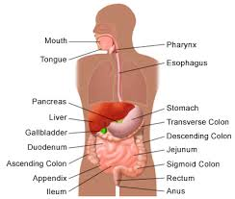
Gastrointestinal
6%
CCRN Review: Gastrointestinal
Hepatic Failure
Pancreatitis
Bowel Obstruction
Abdominal Trauma
9 Questions

Slide 55

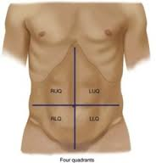
Bowel Assessment
Auscultate for 2-5 minutes in each quadrant
Normal amount of bowel sounds = 5-34 rumbles/minute

Slide 56
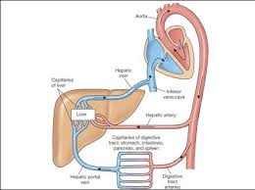

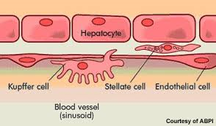
Hepatic Failure
Your liver receives 1500 ml of blood per minute!
Hepatocytes
Produce bile
Metabolize hemoglobin Globin energy source Heme bilirubin
Metabolism
Glucose Glycogen Amino acids Ammonia
Urea
Kupffer cells in the liver catch and destroy old, worn out red blood cells and pass their components on to hepatocytes.

Slide 57
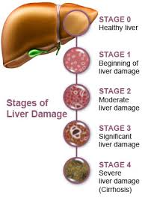


Hepatic Failure
Potassium Levels
BUN
Proteins
Acids
    Metabolic Acidosis
    Ringers Lactate
AMMONIA
LEVELS
Hepatic
Encephalopathy

Slide 58

Hepatic Failure
? ? ? ? ?
Complication of Neomycin Therapy?
VITAMIN
DEFICIENCY
Water-soluble vitamins are absorbed in the upper small intestine: B-complex vitamins (i.e. Thiamine, Riboflavin, Folic Acid)

Slide 59
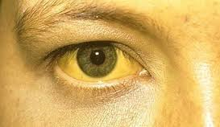

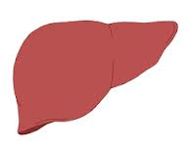

Hepatic Failure
Your Patient is Jaundice, is it Hepatic Failure or Biliary Tract Disease?
Indirect Vs. Direct Bilirubin
Indirect or Unconjugated Bilirubin
Mr. Bilirubin
Ms. Albumin
Hepatic Failure
Liver Disease
Unconjugated or Indirect
= Conjugated or Direct
Direct or Conjugated Bilirubin
Gallbladder
Or
Biliary Tract Disease

Slide 60
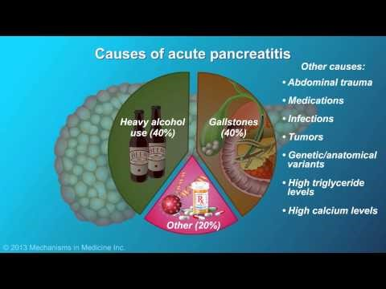
Pancreatitis

Slide 61
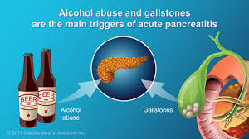
Pancreatitis
Causes
Obstruction of pancreatic duct
      Gallstones & Infection
Alcoholism
Drug Toxicity
      Cyclosporine, Steroids, Thiazides, Tetracycline
Trauma

Slide 62
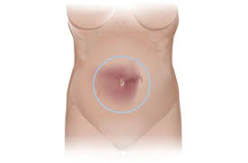
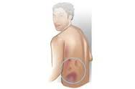
Pancreatitis
Amylase & Lipase
In a healthy individual, a normal blood amylase level is 23-85 U/L (some lab results go up to 140 U/L). A normal lipase level is 0-160 U/L. If the pancreas is damaged, these digestive enzymes can be found in the blood at higher levels than normal. Blood levels more than four times normal levels of amylase (>450 U/L) and lipase (>400 U/L), likely indicate pancreatic damage or pancreatitis.
Cullen’s Sign
Gray-Turners

Slide 63
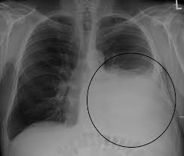
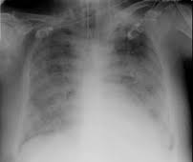
Pancreatitis
Complications
Hypocalcemia
HHNK
Left sides atelectasis
Left sided pleural effusions
Bilateral Rales
ARDS

Slide 64
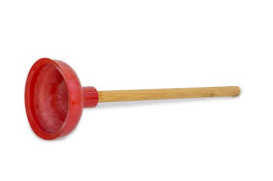
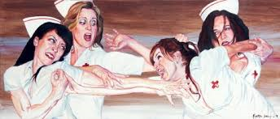
Bowel Obstruction
Large Bowel Obstruction | Small Bowel Obstruction
Large Distention | Small Distention Diarrhea Vomiting
I’ll Take The
Large Bowel

Slide 65
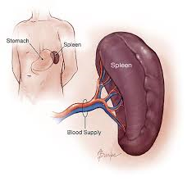
Abdominal Trauma
Ruptured Spleen
55% Kehr’s Sign
(Left Shoulder Pain)
Notes:
Saegasser's sign - Palpation of left upper quadrant inferior to ribs elicits neck pain in the patient.

Slide 66
In order to most accurately establish that your patient has no bowel sounds, you must listen in each quadrant for at least:
1 full minute
30 seconds
2-5 minutes
1 ½ minutes

Slide 67
The usual order for carrying out physical assessment of abdomen is:
Inspection, auscultation, percussion, palpation
Palpation, inspection, auscultation, percussion
Auscultation, percussion, palpation, inspection
Percussion, auscultation, inspection, palpation

Slide 68
The function of the liver includes all of the following except:
Synthesizes amino acids and albumin
Hepatocytes secrete bile
Formation of ammonia to remove urea from the blood
Synthesizes prothrombin, fibrinogen, and albumin

Slide 69
Nursing interventions for the patient with hepatic failure include:
Restrict protein in the diet
Avoid use of narcotics, sedatives, and tranquilizers
Administer lactulose and neomycin as prescribed
All of the above

Slide 70
The underlying cause of most esophageal varices is:
Acid pepsin erosion secondary to gastroesophageal reflux
Portal hypertension due to liver disease
High venous pressure at the esophagogastric junction due to systemic hypertension
Traumatic esophageal damage

Slide 71
The rationale for the use of neomycin in the setting of liver failure is to:
Prevent the likelihood of sepsis in the event of severe GI bleeding
Promote the manufacture of prothrombin by activating vitamin K
Inhibit the production of ammonia by intestinal bacteria
Establish a blood level of antibiotics in anticipation of surgery

Slide 72
Urea is formed by the liver to rid the body of:
Creatinine
Bicarbonate
Bilirubin
Ammonia

Slide 73
The inability of the liver to conjugate what substance is a primary contributor to hepatic coma?
Ammonia
Urea
Fatty acids
Bilirubin

Slide 74
Which of the following may precipitate the onset of hepatic encephalopathy in patients with sever liver dysfunction?
Diuretics
Acute Infection
GI Bleeding
All of the above

Slide 75
Which of the following may contribute to the precipitation of encephalopathy in the patient with liver failure?
GI Bleeding
Hypokalemia
Hypotension
All of the above

Slide 76
Ecchymosis around the umbilicus indicative of peritoneal bleeding is called:
Chvostek’s sign
Cullen’s sign
Grey Turner’s sign
Trousseau’s sign

Slide 77
Pulmonary complications of acute pancreatitis may include:
Acute respiratory distress syndrome
Elevation of the diaphragm and bilateral basilar crackles
Atelectasis, especially of the left base
All of the above

Slide 78
Which of the following analgesics is the drug of choice in managing the pain of acute pancreatitis?
Demerol
Morphine
Codeine
Dilaudid

Slide 79
A bluish-green-brown discoloration in the flank and groin due to retroperitoneal bleeding is called:
Grey-Turners sign
Cullen’s sign
Kernig’s sign
Welch’s sign

Slide 80
Patient assessment findings indicative of a bowel infarction would include:
Hypoactive bowel sounds and leukocytosis
Hyperresonance and abdominal tenderness
Absence of dullness in the liver area
All of the above

Slide 81
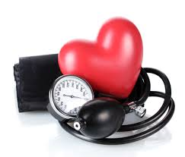
CCRN: Cardiovascular
Hypertensive Crisis
Essential Hypertension
Accelerated Hypertension: DBP > 120 mm Hg
Associated with retinal hemorrhages
Malignant Hypertension: DBP > 140 mm Hg
Associated with retinal hemorrhages and papilledema
Treatment: Vasodilators and Sympathetic Blocking Agents

Slide 82
CCRN: Cardiovascular
Cardiomyopathy
3 Types
Dilated Cardiomyopathy
Hypertrophic Cardiomyopathy
Restrictive Cardiomyopathy

Slide 83

CCRN: Cardiovascular
Cardiomyopathy
Hypertrophic Cardiomyopathy (HCM)
Hypertrophic Obstructive Cardiomyopathy (HOCM)
Idiopathic Hypertrophic Subaortic Stenosis (IHSS)
Increased thickening of heart muscle and septum, inwardly at the expense of the left ventricular chamber
Ventricle becomes rigid and stiff, restricting filling
Stoke Volume & Cardiac Output decreases
Beta-Blockers
&
Calcium Channel Blockers
CONTRAINDICATED:
Digoxin, Nitrates, Dopamine, Isuprel, Morphine

Slide 84
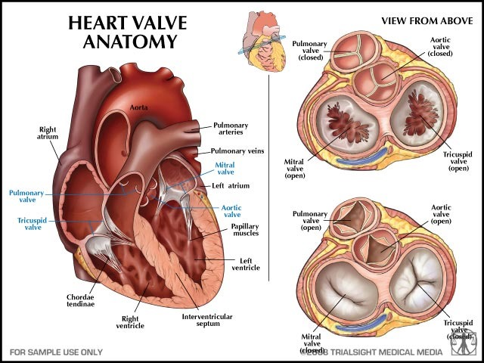
CCRN: Cardiovascular
Valvular Disease: Murmurs
Two Common Causes of Murmurs
FORWARD flow of blood through stiff stenotic OPEN valves
BACKWARD flow of blood through incompletely CLOSED valves

Slide 85

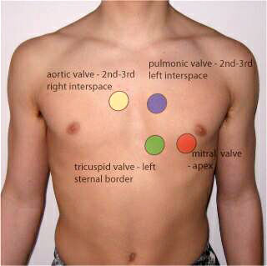


CCRN: Cardiovascular
Valvular Disease: Murmurs
LOCATION, LOCATION, LOCATION
Diastolic Murmur
S1 S2 MMMMMMMM
Systolic Murmur
S1 MMMMMMMM S2

Slide 86

CCRN: Cardiovascular
Valvular Disease: Murmurs
DIASTOLIC MURMUR
Mitral Stenosis
Low pitched, crescendo, rumbling noise heard at apex that will increase in left lateral position.
Causes include calcification of leaflets

Slide 87
CCRN: Cardiovascular
Valvular Disease: Murmurs
DIASTOLIC MURMUR
Aortic Insufficiency
High pitched, decrescendo, blowing noise heart at 2nd RICS that increases with exhalation.
Causes include systemic hypertension & Rheumatic Heart Disease

Slide 88
CCRN: Cardiovascular
Valvular Disease: Murmurs
SYSOLIC MURMUR
Aortic Stenosis
Medium pitched, crescendo-decrescendo, radiating to the neck and right carotid which increases with sitting and holding one’s breath.
Causes include calcification of valves and Rheumatic Fever

Slide 89
CCRN: Cardiovascular
Valvular Disease: Murmurs
SYSTOLIC MURMUR
Mitral Insufficiency
High pitched, plateau blowing quality heard at apex which radiated to axilla. Increases with squatting.
Causes include Myocardial Infarction & Rheumatic Heart Disease

Slide 90

A patient with a blood pressure of 200/142 mmHg would have which of the following forms of hypertension?
Essential hypertension
Accelerated hypertension
Malignant hypertension
Hypertensive encephalopathy

Slide 91
Your patient has just been diagnosed with Idiopathic Hypertrophic Subaortic Stenosis, you as the nurse know that this results in a decrease in cardiac output. Which of the following pharmacological modalities should be given to your patient to improve the cardiac output?
Nitroglycerin
Digoxin
Dopamine
Inderal

